Slide 1
BST and Heaps
Unit 6
CPRG304 – Object-Oriented Programming III

Slide 2
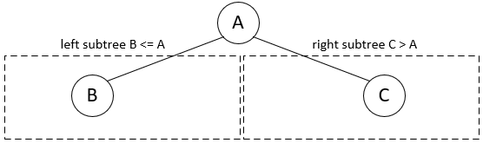
Binary Search Trees (BST)
A binary tree that is organized in a special way!
  Binary “Sorted” Tree
For any node in the tree:
  All nodes in the left subtree, if not empty, contains elements less than or equals to the node element
  All nodes in the right subtree, if not empty, contains elements greater than the node element
Notes:
“Binary Search” Tree – built to perform binary searches!

Slide 3
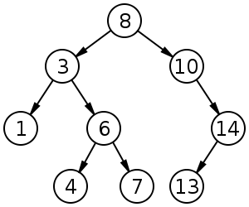
Searching in a BST
Find “7”
  Start at the root node
  Compare node element to target element
    If target is less than or equals, go down left subtree
    If target is greater than, go down right subtree
  Repeat until target element is found
Notes:
Img stolen from Wikipedia :D

Slide 4
BSTreeNode for Strings
Java class implementing BST nodes:
  public class BSTreeNode {
  private String element;
  private BSTreeNode left, right;
  public BSTreeNode(String elem, BSTreeNode left,
  BSTreeNode right){
  this.element = elem;
  this.left = left;
  this.right = right;
  }
  // other BSTreeNode methods
  }
Notes:
Very similar to a DLL node!

Slide 5
BST of BSTNode for Strings
Java class implementing BST:
  public class BSTree {
  private BSTreeNode root;
  public BSTree() {
  // Construct an empty BST.
  this.root = null;
  }
  public BSTree(String element) {
  this.root = new BSTreeNode(element, null, null);
  }
  // other BSTree methods
  }

Slide 6

BSTreeADT Requirements
Check out the ADT for assignment 3!
  Many “normal” operations you would expect…
Except:

Slide 7
Tree Traversal
Definition: the process of visiting each node (element) of the tree exactly one time
  “Linearizing” a tree
Order is not specified by the definition
  There are as many tree traversals as there are permutations of nodes!
    For a tree with n nodes, there are n! different traversals
    Most are chaotic and useless
    Some will provide us a meaningful walkthrough of all elements
Notes:
Recall definition of traversal vs iteration – means the same thing in linear data structures (from one end to the other end) but very different in trees! What would you define as the start/head/first element? What about the end/tail/last? And what order of each node comes in-between??
For trees, the process of traversing (walkthrough) can pass through the same nodes multiple times. To iterate through a tree, we need to traverse it (in whichever way) to give us a “list” of each element.
- From each node, we can follow left/right child to either subtree… which path you take would end up taking you through the tree in different ways!

Slide 8
General Tree Traversal Classes
Breadth-first
  Top-down, left-right: 8 3 10 1 6 14 4 7 13
  Top-down, right-left: 8 10 3 14 6 1 13 7 4
  Bottom-up, left-right: 4 7 13 1 6 14 3 10 8
  Bottom-up, right-left: 13 7 4 14 6 1 10 3 8
Height/Depth-first
  Follow the links!
    Better performance
Notes:
Breadth-first is more intuitive to us humans, especially when we draw it out and look at the tree visually… but not so much for dumb computers! It’s very expensive and inefficient to go from one sibling to another! (Imagine going from 7 to 13)

Slide 9
Height-First Traversal
Proceeds as far as possible to the left (or right), then backs up until the first crossroad, goes one step to the right (or left), and again as far as possible to the left (or right)
  Repeat this process till all nodes are visited
Three tasks of interest:
    V – visiting a node
    L – traversing the left subtree
    R – traversing the right subtree
  These task should be performed in the same order for each node, but which order?
Notes:
“Visiting a node” = retrieving the element in our iterator… we can access a node without visiting it!
- Like a simple getter i.e. getElement()

Slide 10
Height-First Traversal Variations
3 tasks = 3! permutations
= 6 ordered height-first traversals:
  1) VLR 4) VRL
  2) LVR 5) RVL
  3) LRV 6) RLV
We can concentrate on just these 3 variations!

Slide 11
Height-First Traversal Variations
VLR: preorder tree traversal
8 3 1 6 4 7 10 14 13
LVR: inorder tree traversal
1 3 4 6 7 8 10 13 14
LRV: postorder tree traversal
1 4 7 6 3 13 14 10 8
Notes:
In-order traversal of a BST visits the elements in sorted ascending order!
If you write out the tree in preorder to the file, reading the file back into the program will let you restore the tree to its original form
If you write out the tree in inorder, you restore the tree to minimum height, this improves performance on the next round!
Postorder is probably not very useful for the assignment, but keep in mind that postorder traversal will generate a postfix representation of the tree, useful for creating the reverse polish notation if you’re working with expression trees!

Slide 12
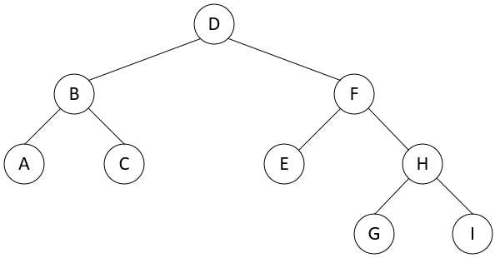
Exercise
What is the order of elements visited using preorder, inorder and postorder traversals?
Notes:
Pre: D, B, A, C, F, E, H, G, I
In: A, B, C, D, E, F, G, H, I
Post: A, C, B, E, G, I, H, F, D

Slide 13
Implementing Tree Traversals
Recursion – short and elegant, but expensive!
  public void preorder( TreeNode p ) {
    if( p != null ) {
    p.visit(); //V
    preorder( p.getLeft() ); //L
    preorder( p.getRight() ); } //R
  }
  public void inorder( TreeNode p ) {
    if( p != null ) {
    inorder( p.getLeft() ); //L
    p.visit(); //V
    inorder( p.getRight() ); } //R
  }
  public void postorder( TreeNode p ) {
    if( p != null ) {
    postorder( p.getLeft() ); //L
    postorder( p.getRight() ); //R
    p.visit(); } //V
  }
Notes:
3 tasks (L, V, R) performed separately, 2 recursive calls – inefficiency doubles!
Run-time stack is being used, what if n is huge? STACK OVERFLOW!

Slide 14
Non-Recursive Implementations
Using stacks!
Pseudocode for preorder:
Push(v)
While (stack != empty)
Pop() //visited
Push(right)
Push(left)
Order: 8 3 1 6 4 7 10 14 13
Notes:
Note: right is pushed before left so it will be on the top of the stack which will be processed first!

Slide 15
Stack Implementation
  public void iterativePreorder() {
    TreeNode p = root;
    Stack travStack = new SLLStack();
    if( p != null ) {
    travStack.push( p );
    while( !travStack.isEmpty() ) {
    p = (TreeNode)travStack.pop();
    p.visit();
    if( ( TreeNode t = p.getRight() ) != null )
    travStack.push( t );
    if( ( TreeNode t = p.getLeft() ) != null )
    travStack.push( t );
    }
    }
  }

Slide 16
BST Operations
BSTs are used to store and retrieve data, so we must have the ability to add, remove and find elements!
Searching: Find a given target value in a BST
  Compare target value with the element in the root node
  If it is equal, the search is successful
  If it is less, search the left subtree
  If it is greater, search the right subtree
  If the subtree is empty, the search is unsuccessful
Notes:
D start

Slide 17
BST Search Example
Find 7
  Start with root node 8
  Go left to node 3
  Go right to node 6
  Go right, found 7
Find 11
  Start with root node 8
  Go right to node 10
  Go right to node 14
  Go left to node 13
  Empty, 11 not found

Slide 18
BST Search Complexity
Analysis (counting comparisons)
  Let the BST’s size be n
  If the BST has height h, the number of comparisons is at most h+1
If the BST is balanced, its height = floor(log₂ n)+1
  Maximum number of comparisons = floor(log₂ n) + 2
  Best-case time complexity is O(log n)
If the BST is ill-balanced, its height is at most n
  Maximum number of comparisons = n+1
  Worst-case time complexity is O(n)

Slide 19
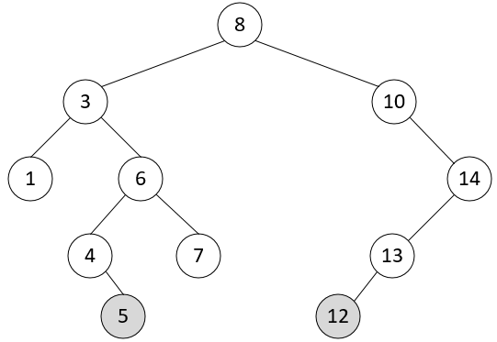
BST Insertion
To insert a new element into a BST, proceed as if searching for that element
  If the element is not already present, the search will lead to a null link
  Replace that null link by a link to a leaf node containing the new element
Add 5 and 12

Slide 20
BST Insertion Complexity
Analysis (counting comparisons)
  Number of comparisons is the same as for BST search
If the BST is balanced its height= floor(log₂ n)+1
  Maximum number of comparisons = floor(log₂ n) + 2
  Best-case time complexity is O(log n)
If the BST is ill-balanced, its height is at most n
  Maximum number of comparisons = n+1
  Worst-case time complexity is O(n)

Slide 21
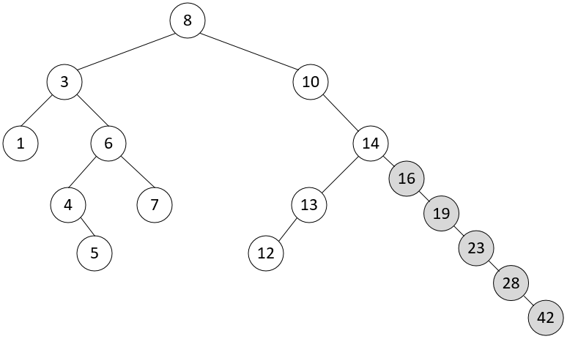
BST in Practice
Whether a BST is well-balanced or ill-balanced depends on the order of insertions
  If the inserted elements are randomly ordered, the BST will probably be reasonably well-balanced
  If the inserted elements happen to be in ascending (or descending) order, the BST will be extremely ill-balanced
Add 16, 19, 23, 28, 42…

Slide 22
BST Deletion
The process for removing a node depends on the number of children the node has!
0 children (leaf node)
  Remove link to the node from parent
  E.g. Delete 13
1 child
  Replace node with child node
  E.g. Delete 10

Slide 23
BST Deletion – Node with 2 children
Must maintain integrity of the BST
  All nodes in left subtree are < or =
  All nodes in right subtree are >
Replace node with the next smaller or next larger element, but how to find the “next smaller” or “next larger” node?
  We know that all smaller elements are in left subtree and all larger are in the right subtree
    Next smaller: go left from node to be removed, keep going right until right subtree is empty
    Next larger: go right from node to be removed, keep going left until left subtree is empty

Slide 24
BST Deletion Example
Delete node 8
  Next smaller (inorder predecessor):
    Go left to node 3
    Go right to node 6
    Go right to node 7
    Right empty, replace 8 with 7
  Next larger (inorder successor):
    Go right to node 10
    Left empty, replace 8 with 10
Notes:
Most common implementations would use the “next smaller” (inorder predecessor) approach because the left subtree can contain another element of the same value as the deleted node.

Slide 25
BST Deletion Complexity
Similar to other operations, performance depends on whether the BST is balanced or not!
  Best-case: O(log n), worst-case: O(n)
Note: Deletion can make a balanced BST ill-balanced, and vice versa
  E.g. Delete 10, 13 and 14
Notes:
BST exercise.

Slide 26
Binary Heaps
Another type of binary tree, similar to BST except:
BST can be different shapes, Heaps are always a complete binary tree
BST is strictly ordered, Heaps are loosely ordered
  BST: all left are < or =, all right are >
  Heaps: root is the smallest (or largest) element in tree, each subtree is also a heap
Max Heap: root is the largest element
Min Heap: root is the smallest element
Notes:
No relations to memory heaps…

Slide 27
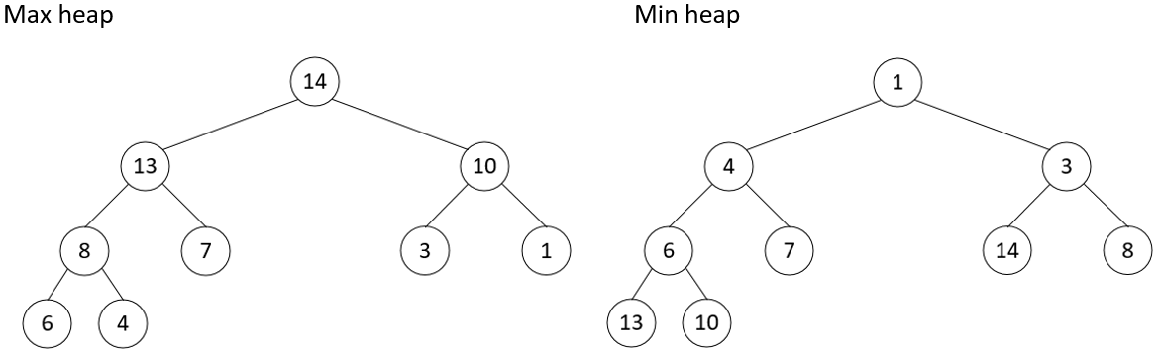
Heaps

Slide 28
Heap Insertion
Add new node to the lowest point in the tree to maintain completeness
  Height level, leftmost available position
Upheap node values to its rightful place in the tree
  Compare with parent node
    If max heap: if parent node is < new node, swap
    If min heap: if parent node is > new node, swap
    Repeat until new node is in place
Example: Start with empty heap, insert 8, 10, 3, 6, 7, 14, 1, 13, 4 (for both max and min heaps)
Notes:
After inserting the above values, the resulting heaps should look exactly like the examples on the previous slide!
https://visualgo.net/en/heap for max

Slide 29
Heap Deletion
Restricted deletion called extraction
  Only the root can be removed from a heap!
Transfer the lowest, rightmost node to the root
  Downheap the node to its rightful place by comparing the new root node to its children nodes
    If max heap: if child node is > new node, swap
      If both children are >, swap with the larger child
    If min heap: if child node is < new node, swap
      If both children are <, swap with the smaller child
    Repeat until new node is in place
Notes:
Converting a binary tree to a heap is known as heapify.

Slide 30
Heap Complexity
Since heaps are always complete, it has the minimum height possible for the number of nodes
Therefore, for any operation, the time is O(log n)
Heaps are great for any applications that require fast access to the smallest (min heap) or largest (max heap) element
  Priority queues
  Heapsort!

